Slide 1
Stability Analysis
10-18-2022

Slide 2
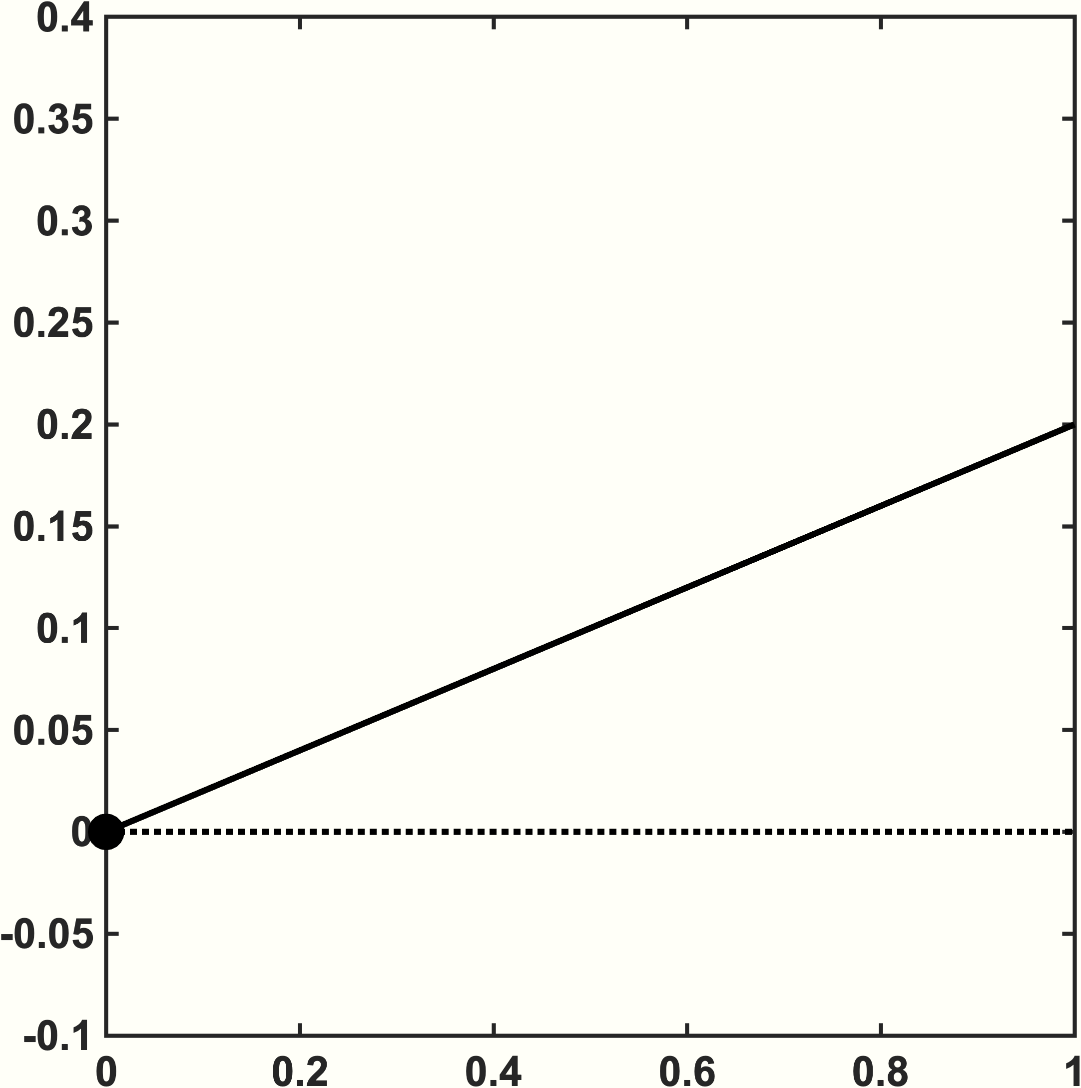
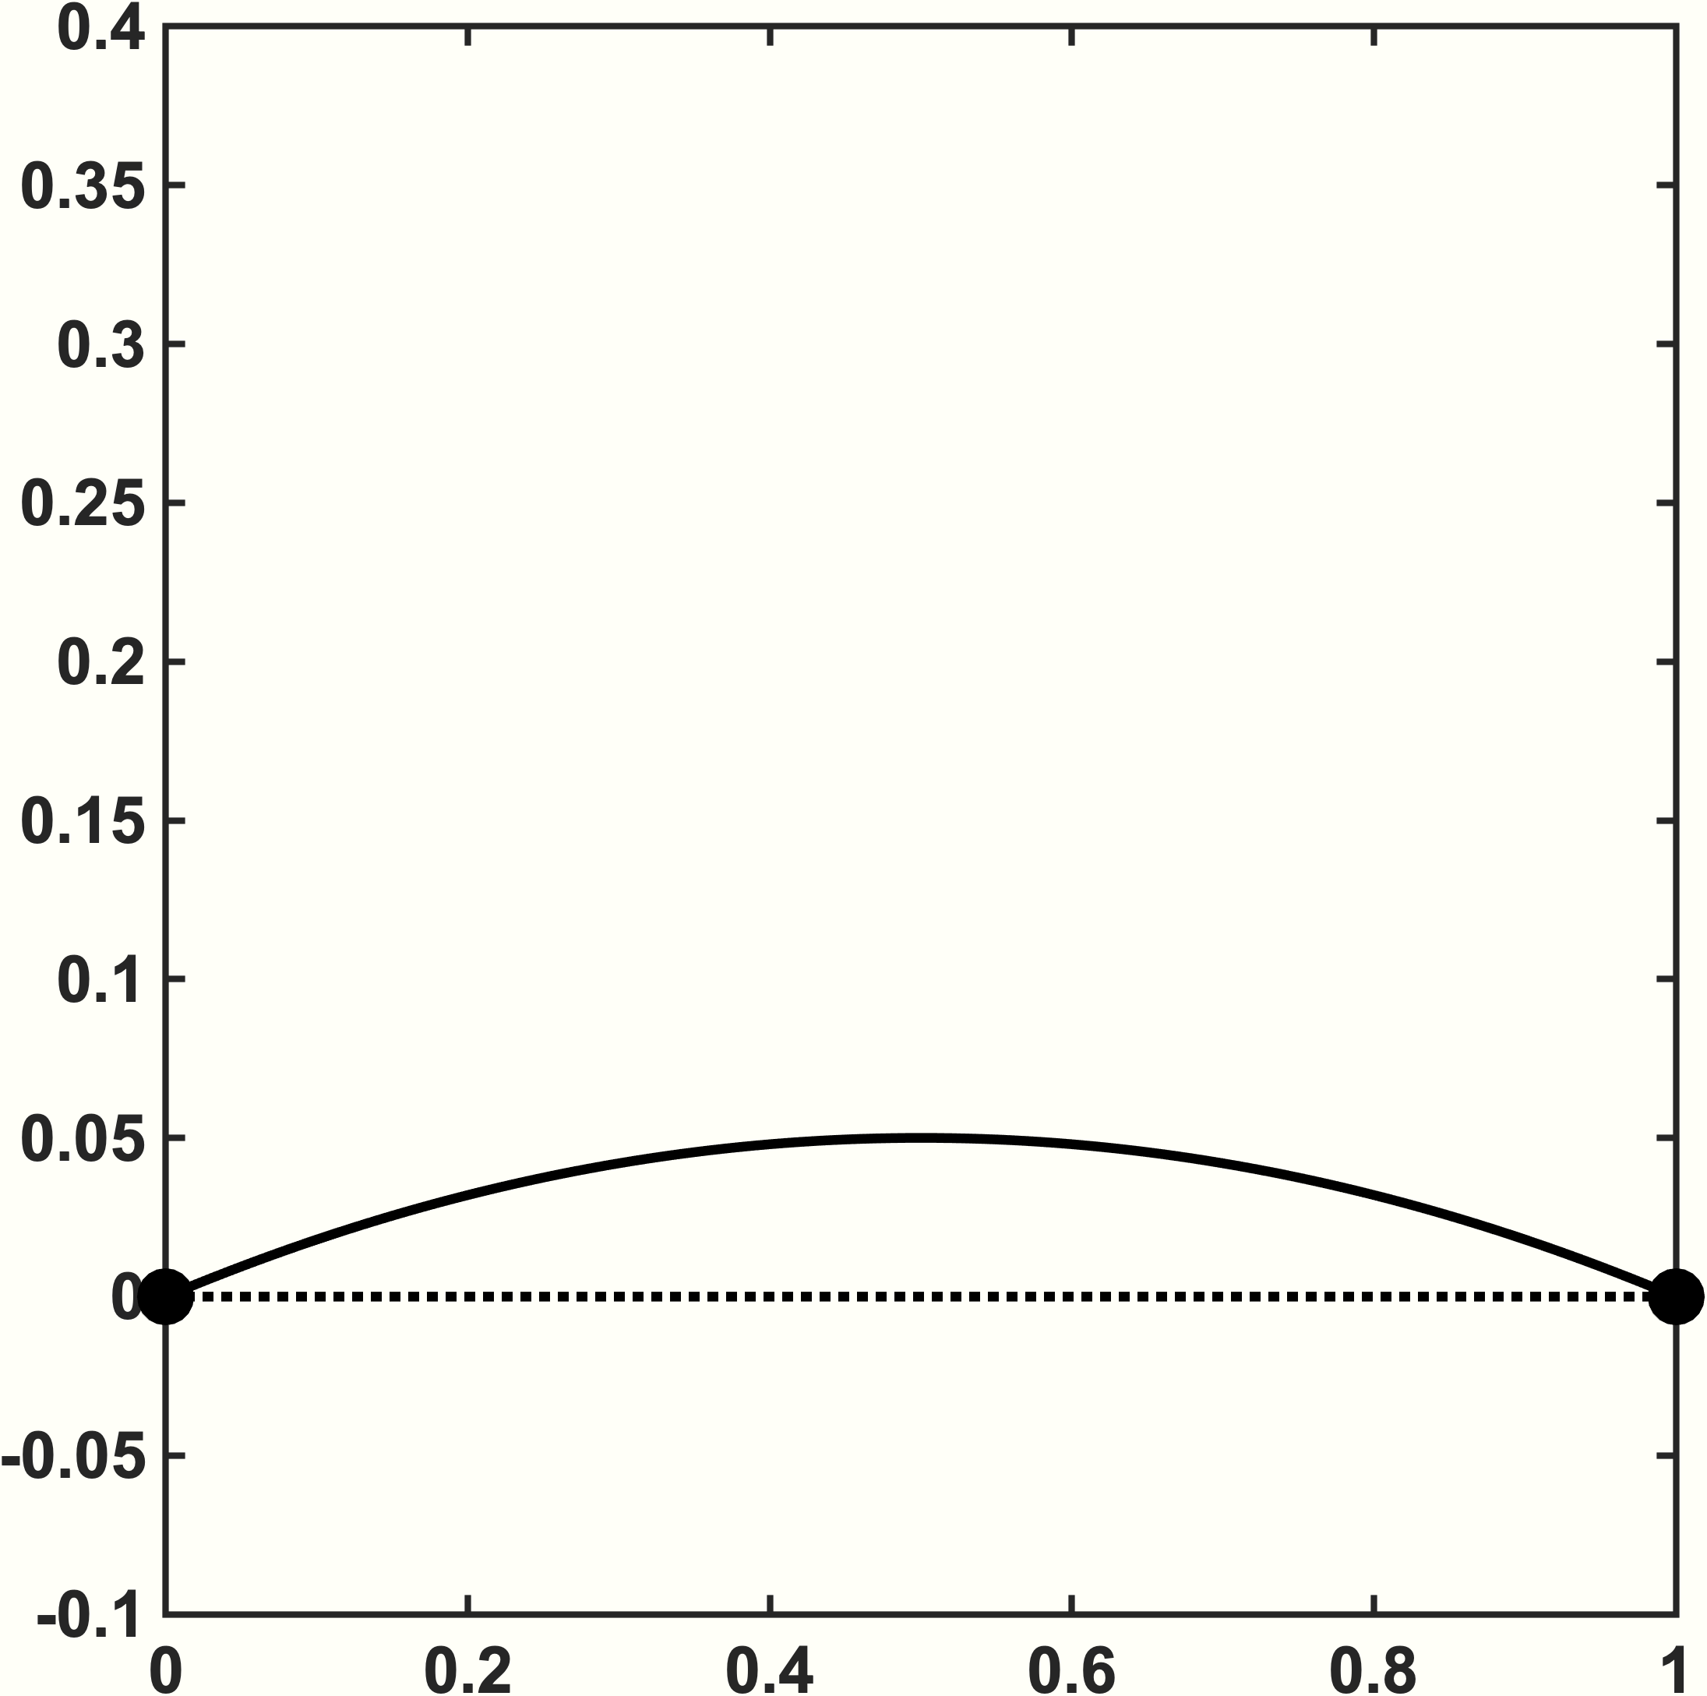
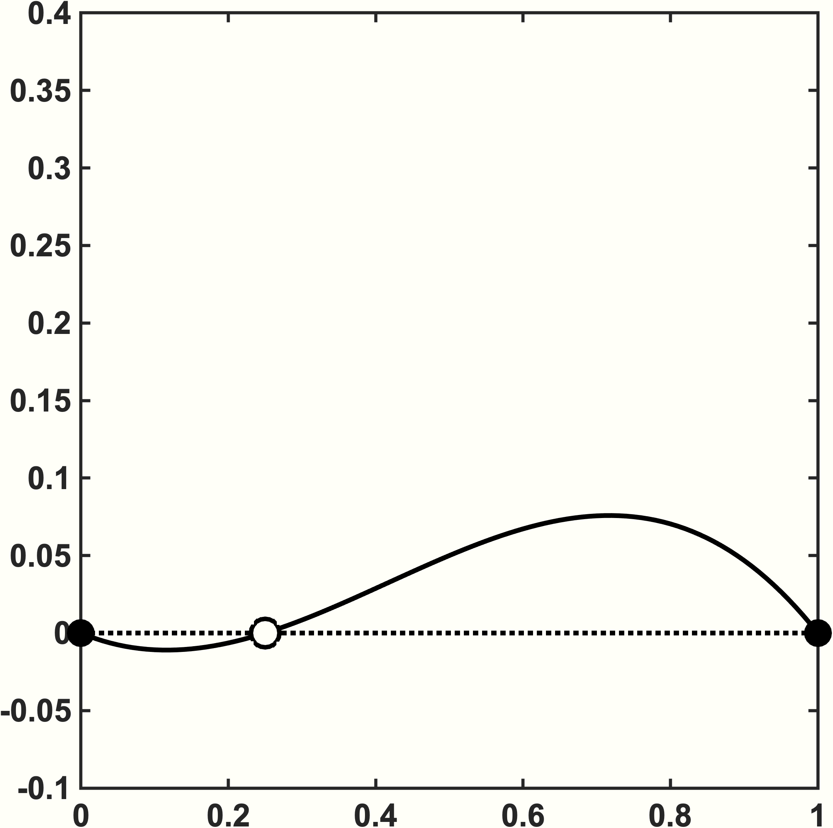
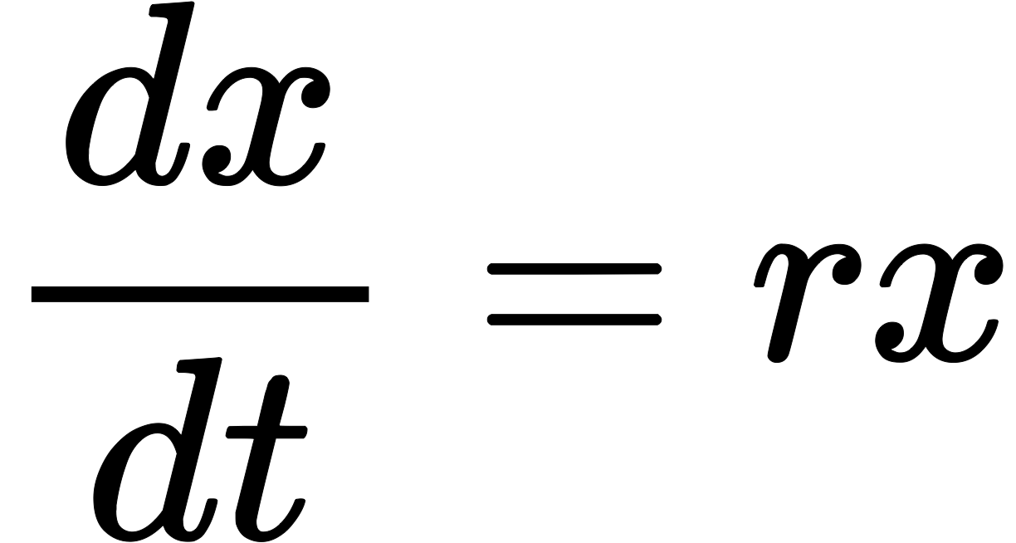
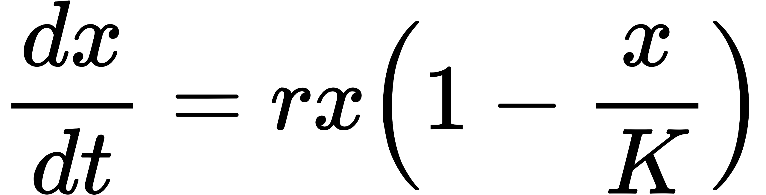
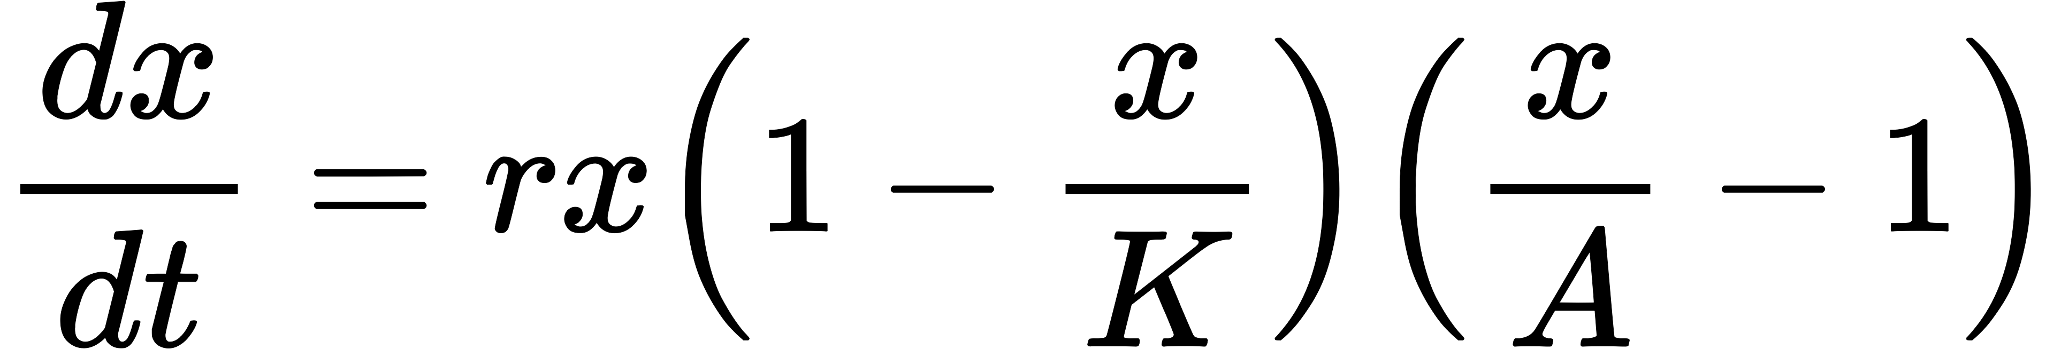
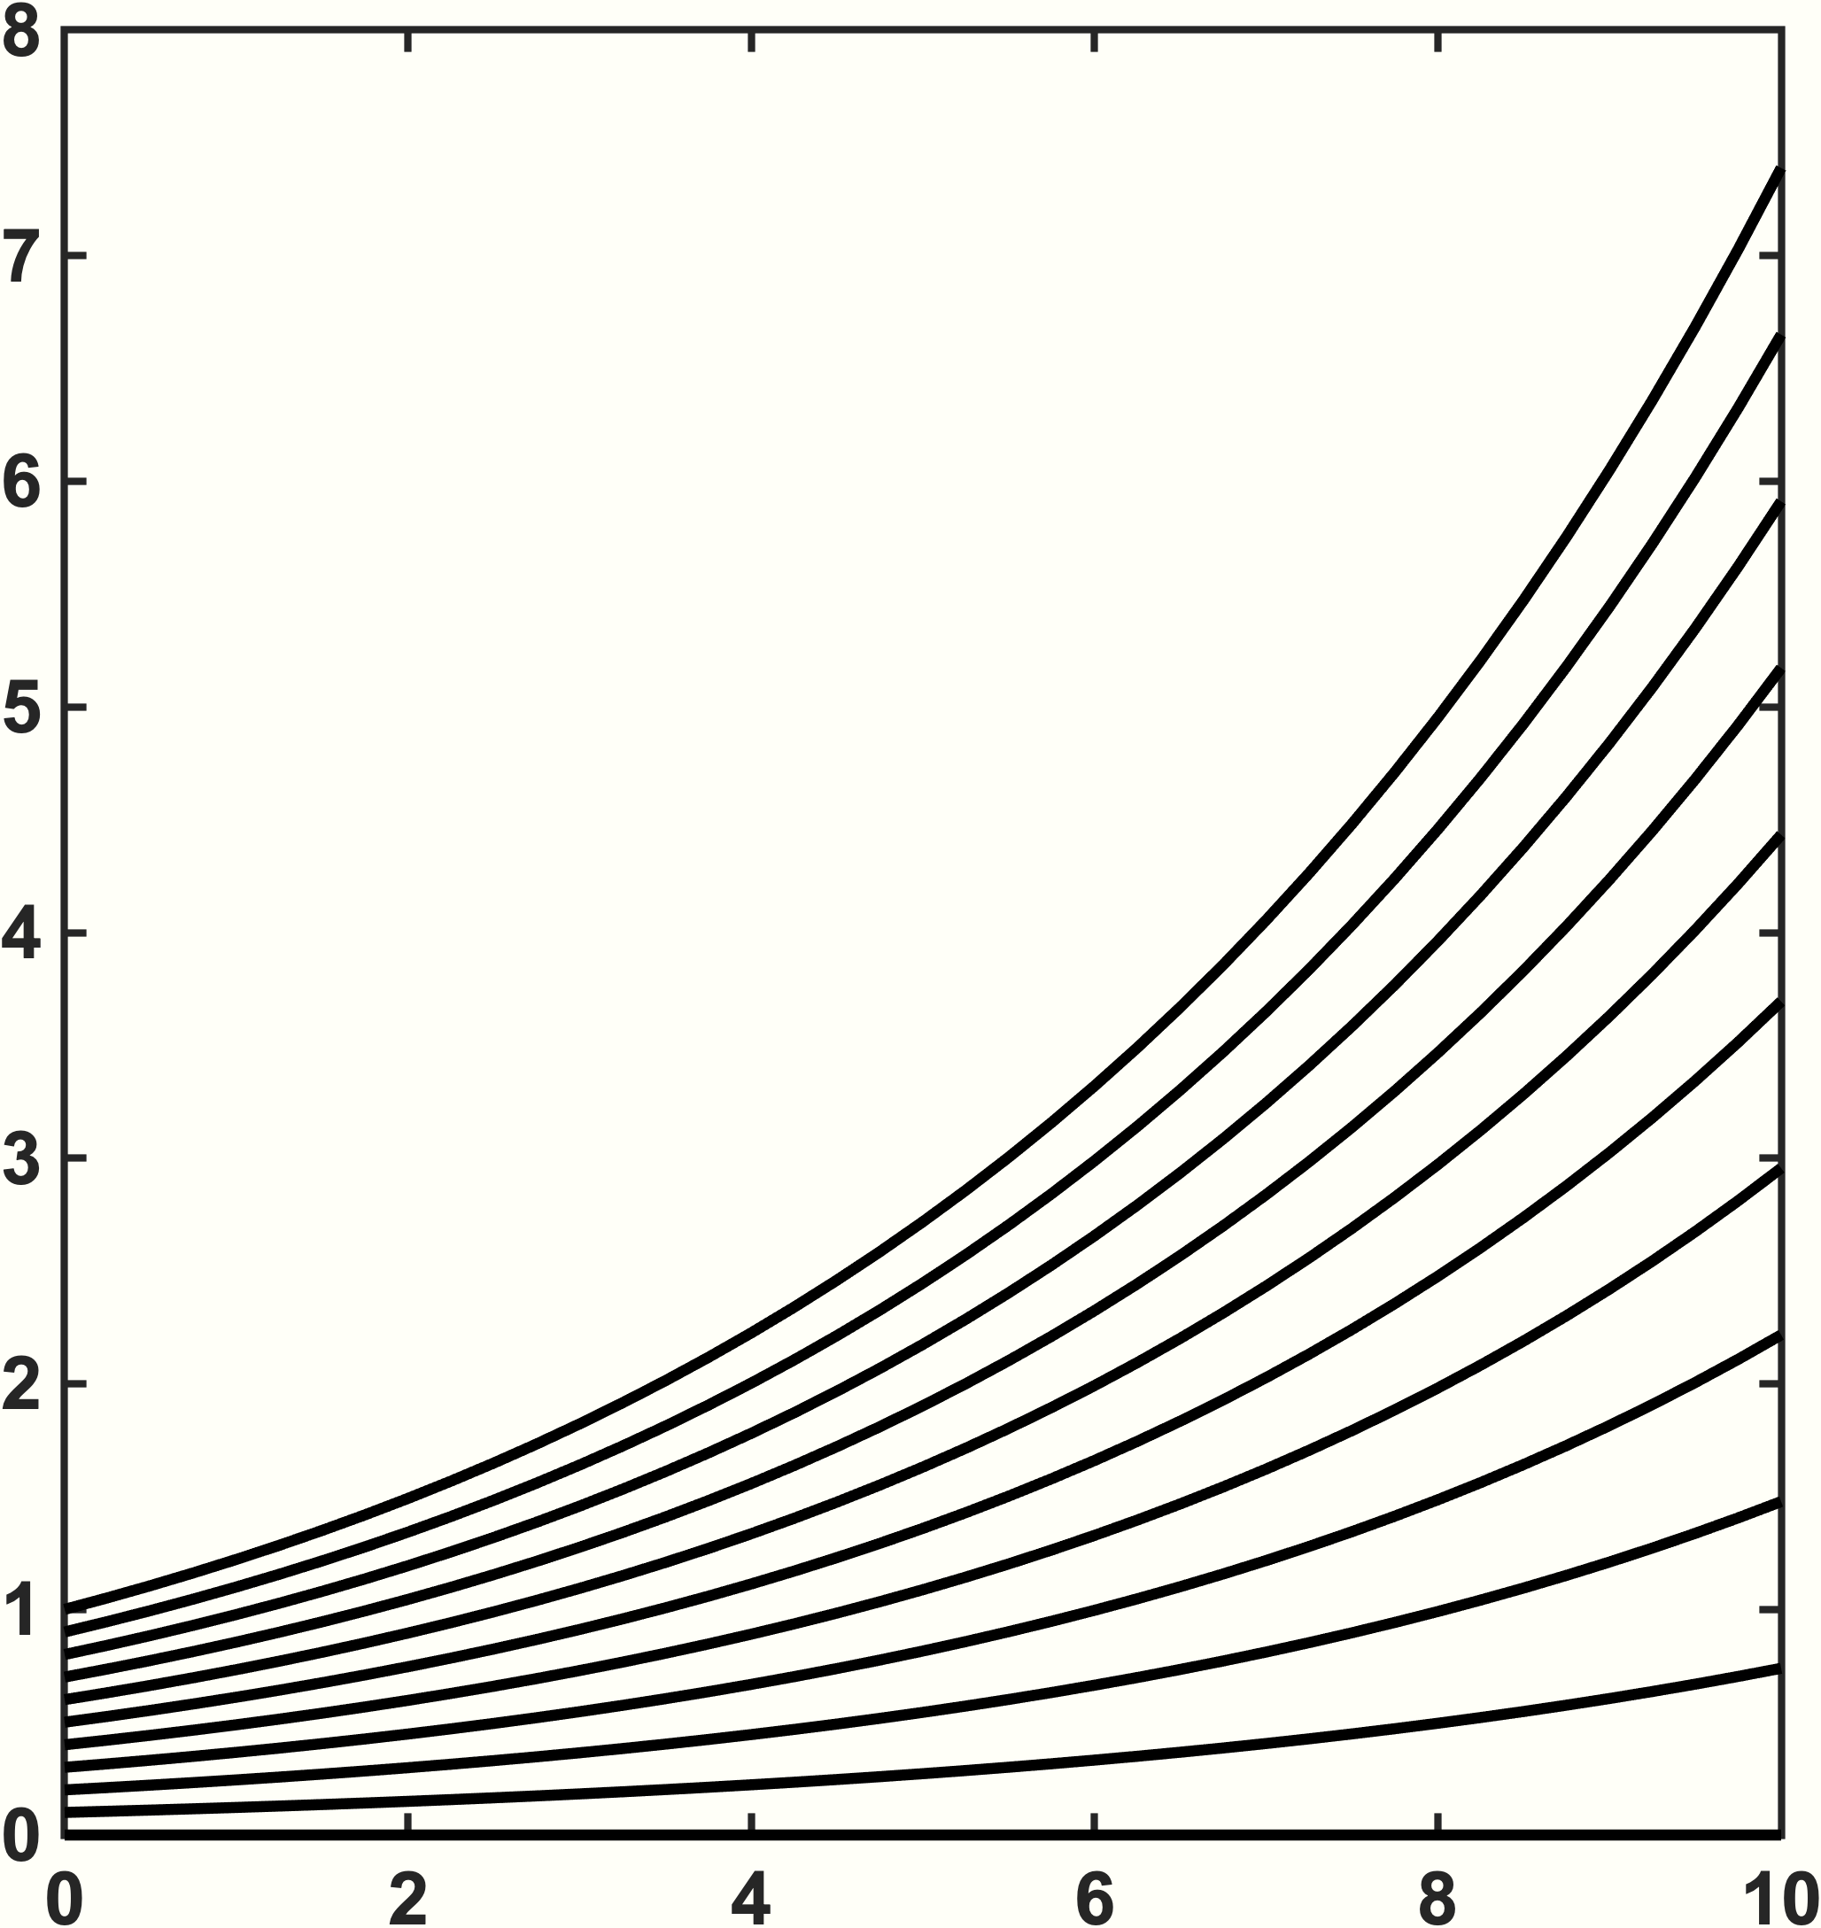
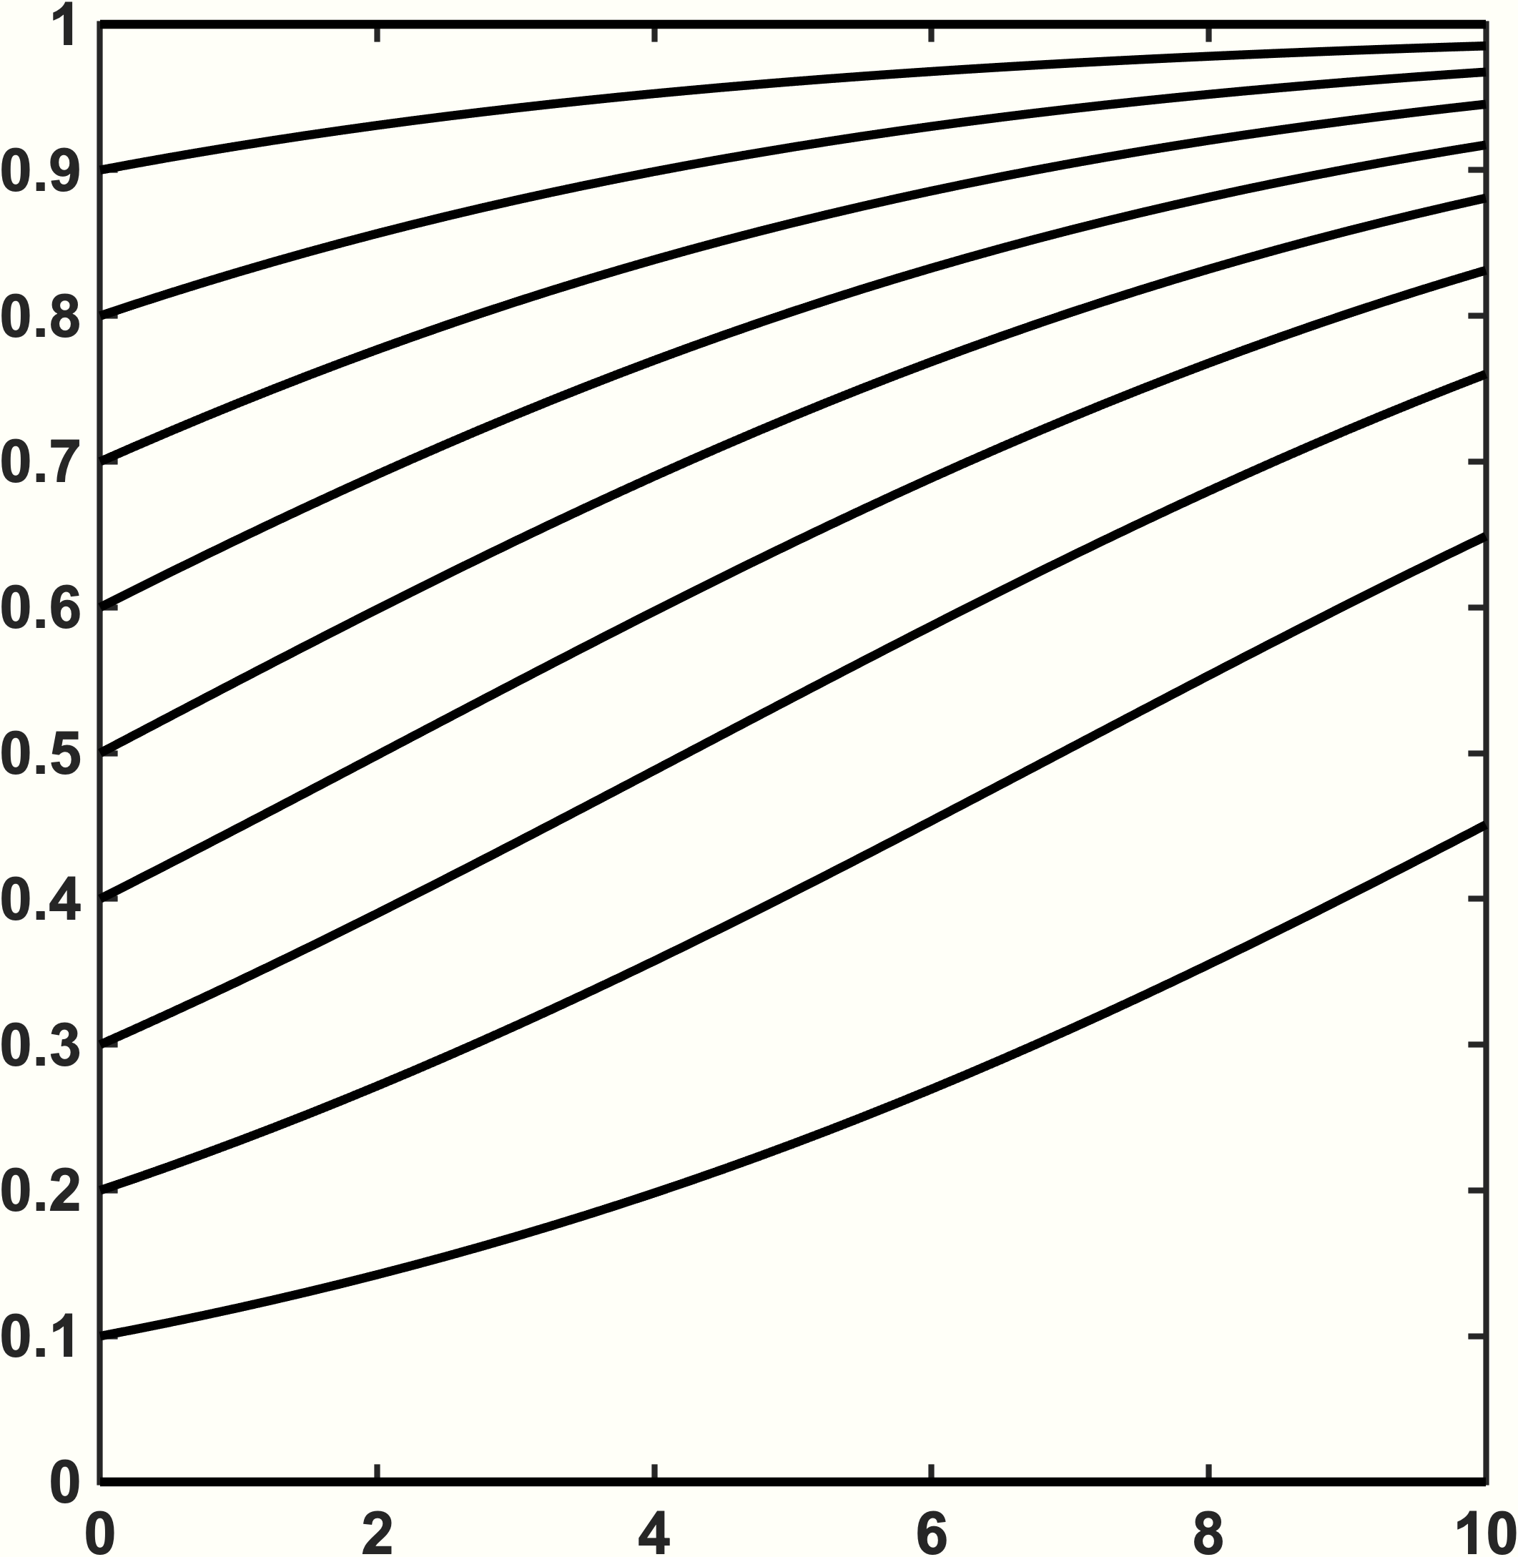
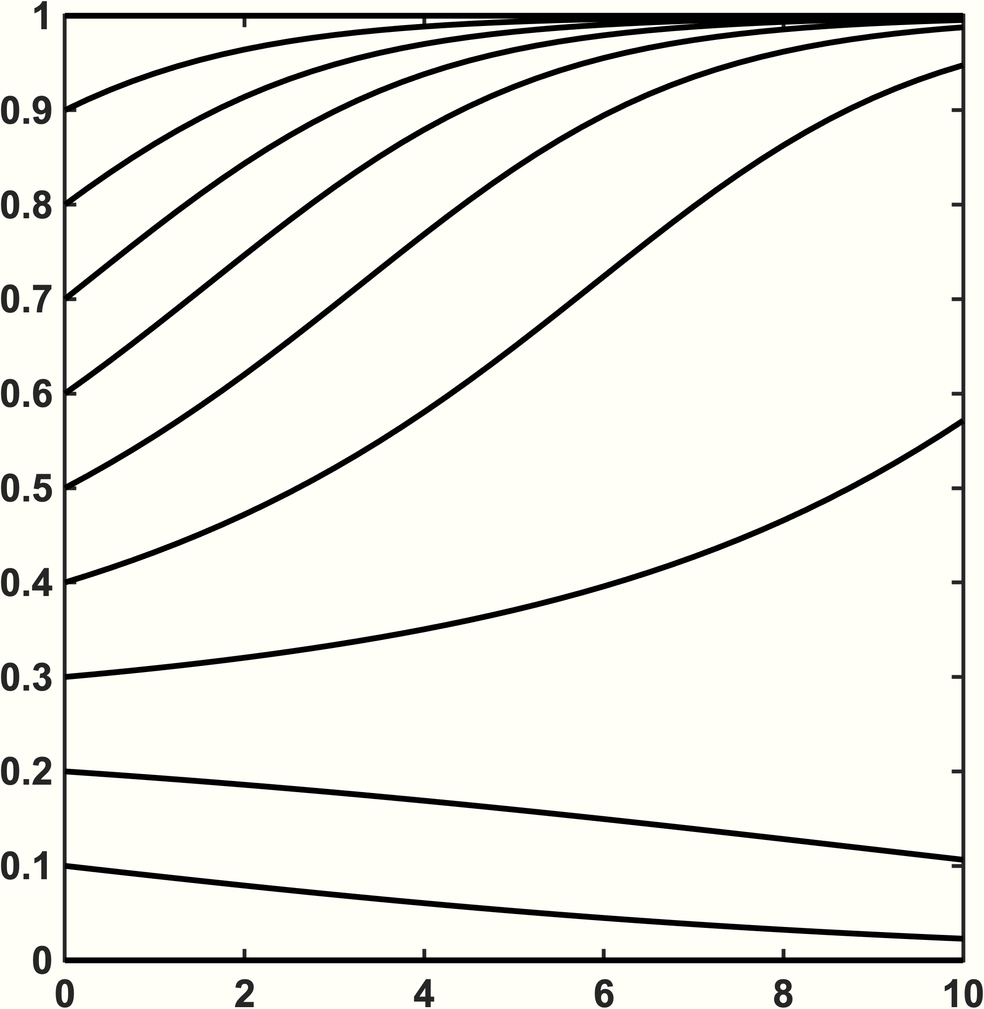



Exponential Growth
Logistic Growth
Logistic w/ Allee
growth rate, $\dot{x}$
growth rate, $\dot{x}$
growth rate, $\dot{x}$
tumor size, x
tumor size, x
tumor size, x
tumor size, x(t)
tumor size, x(t)
tumor size, x(t)
time, t
time, t
time, t

Slide 3
Sink
Source
Neutral
Saddle
x₂
Spiral sink
Spiral source
Center
x₁

Slide 4
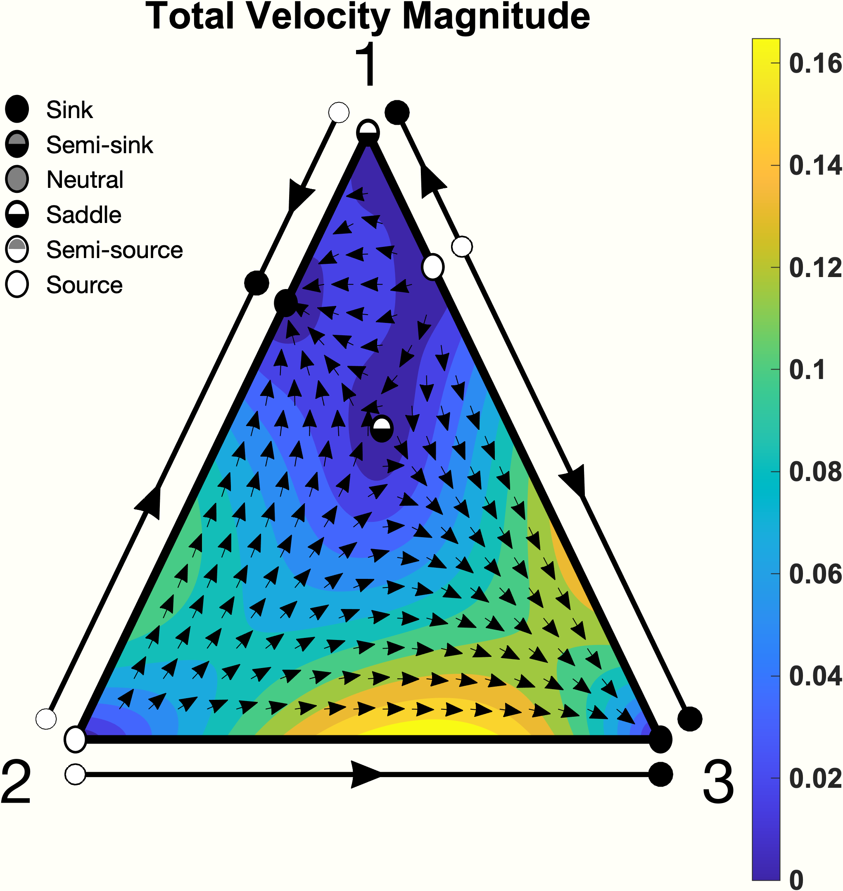
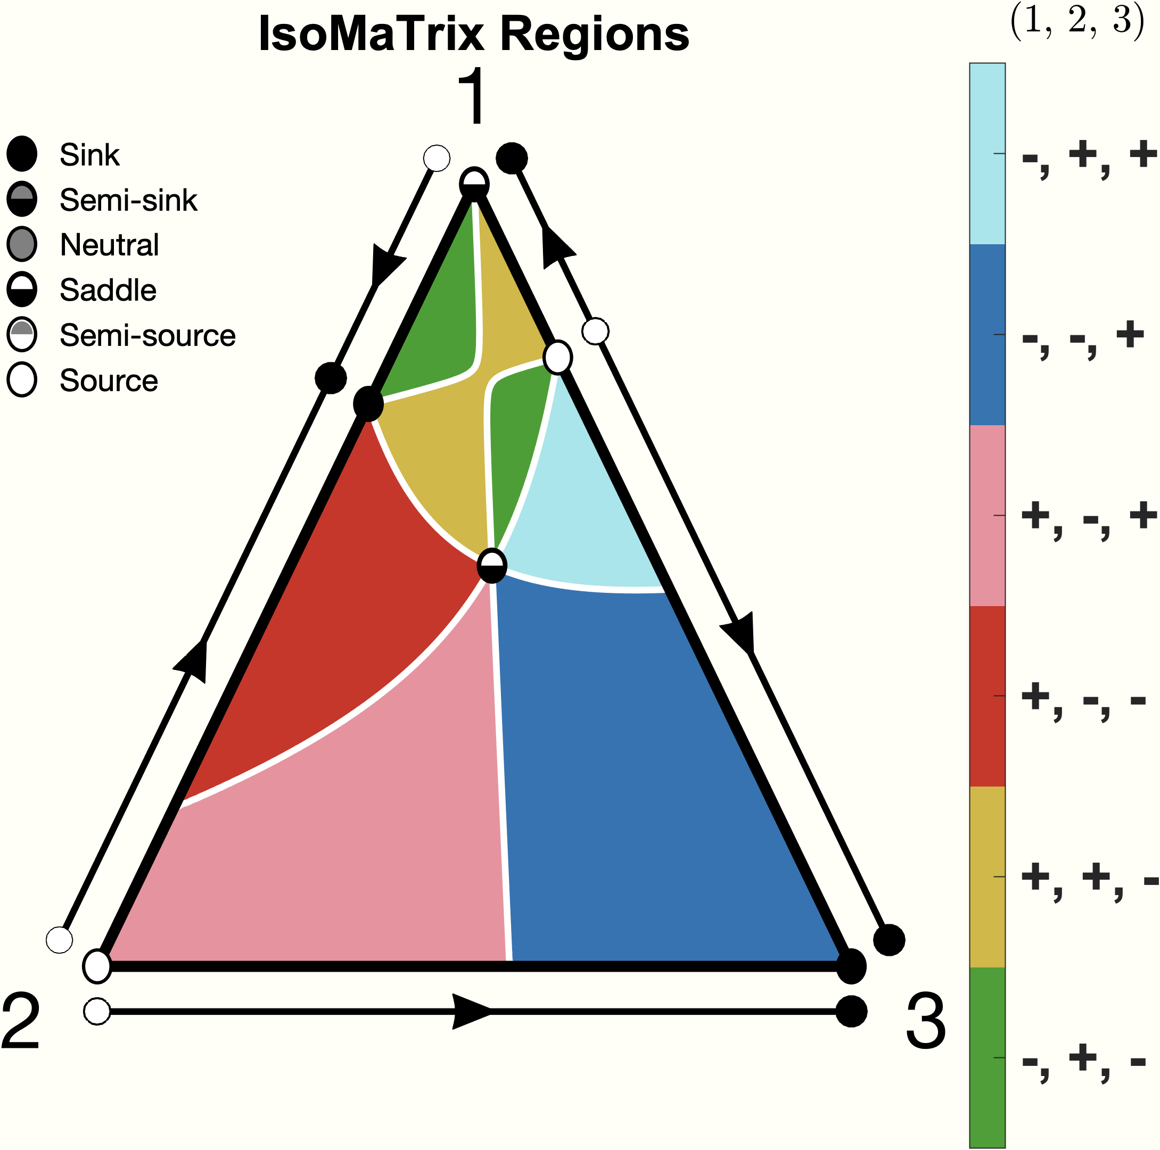
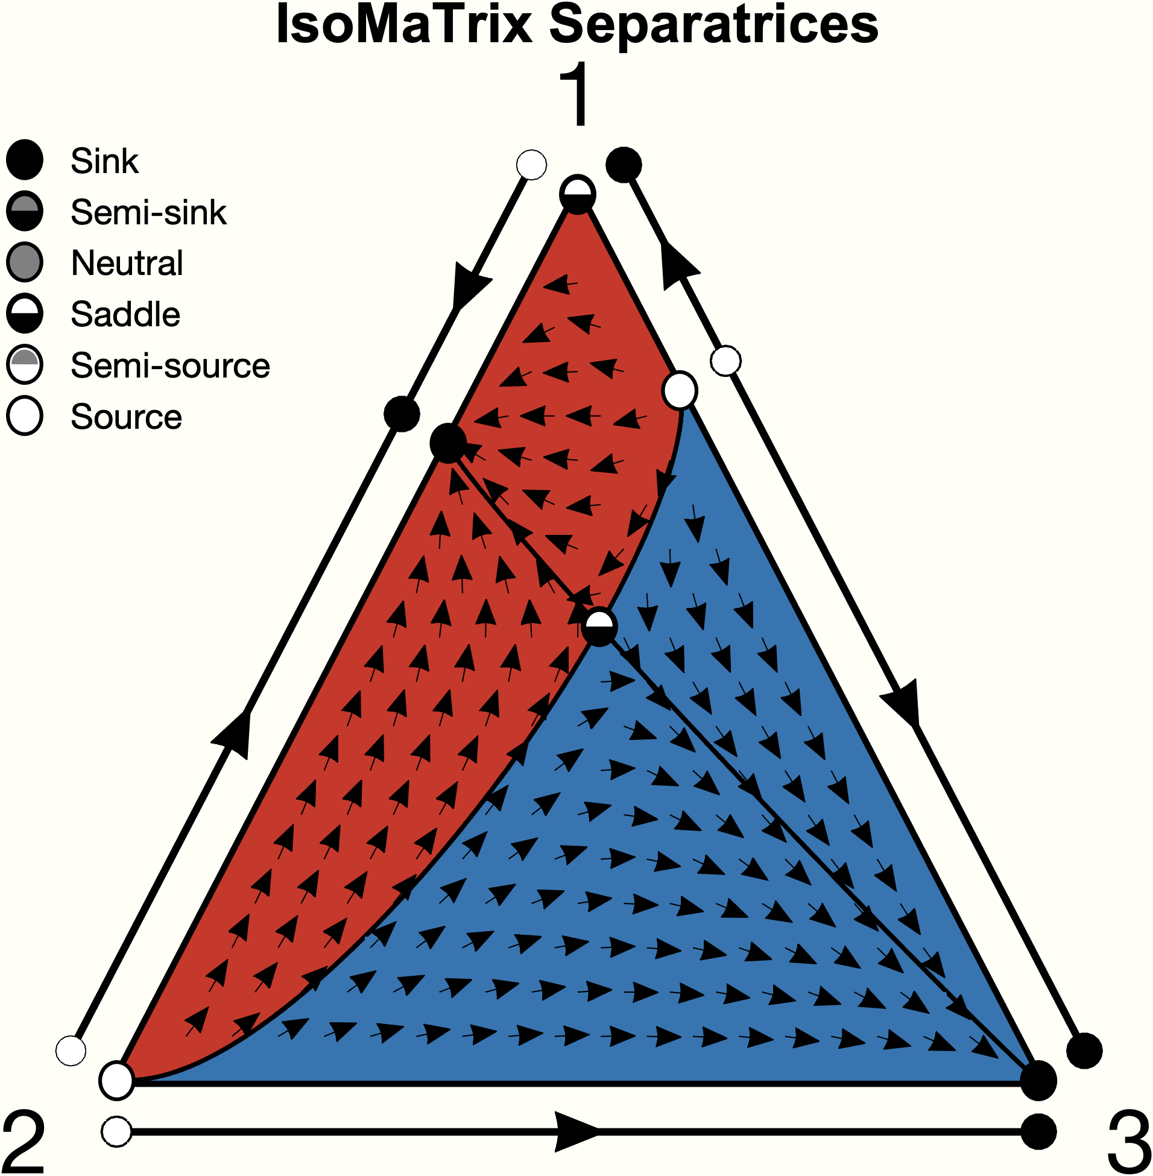
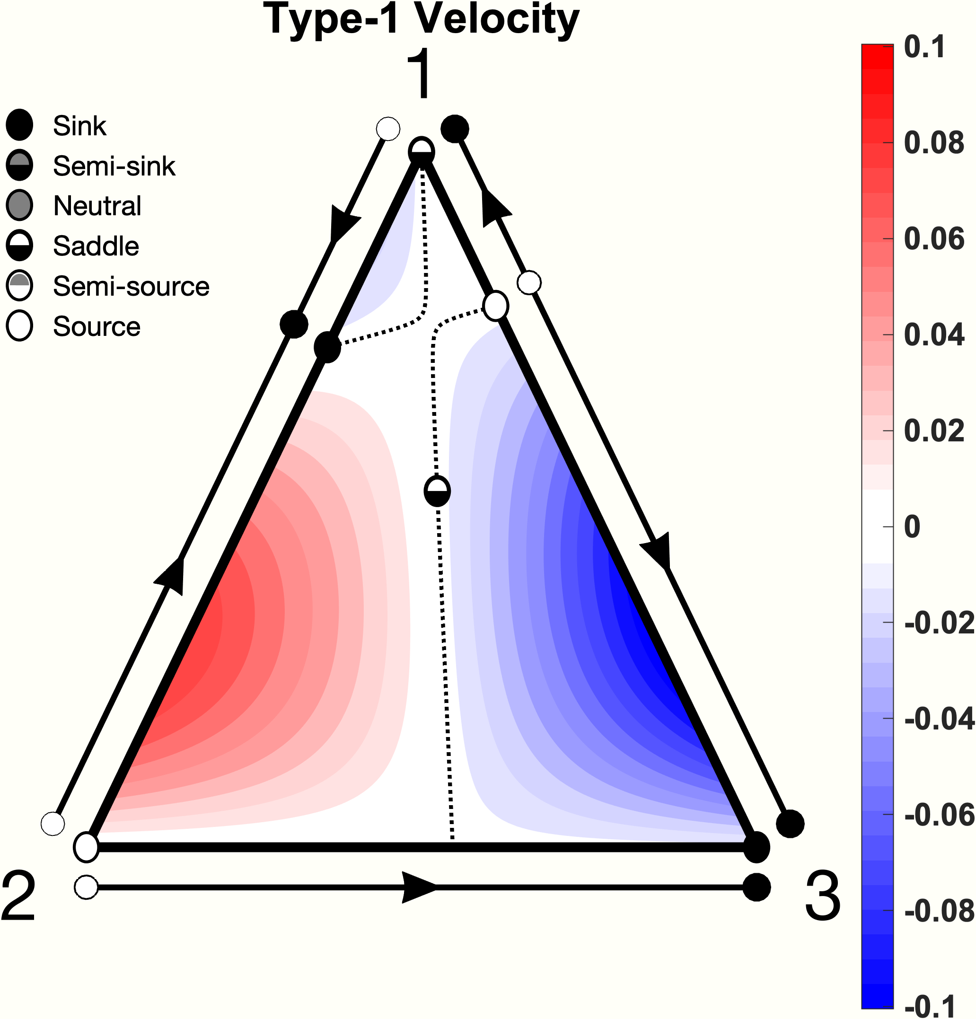
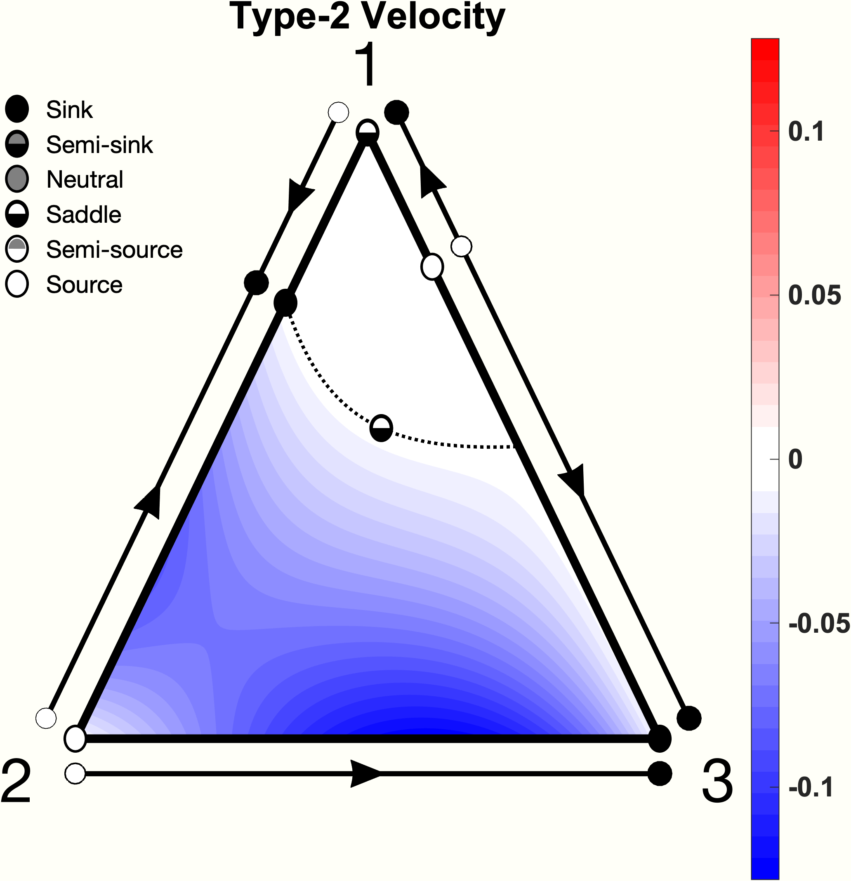
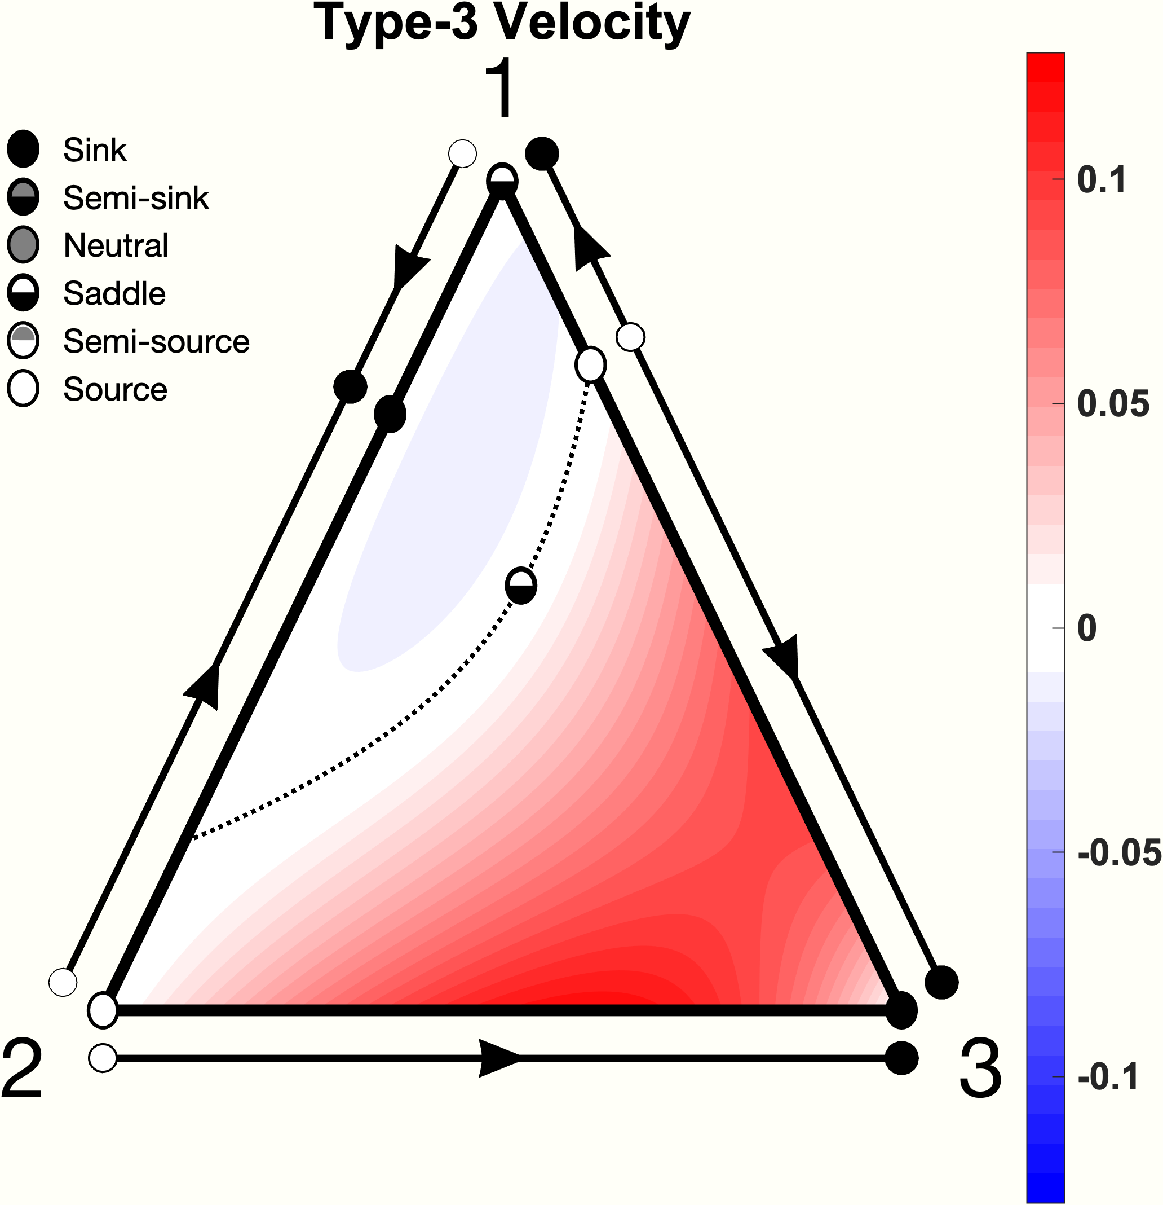

Slide 5
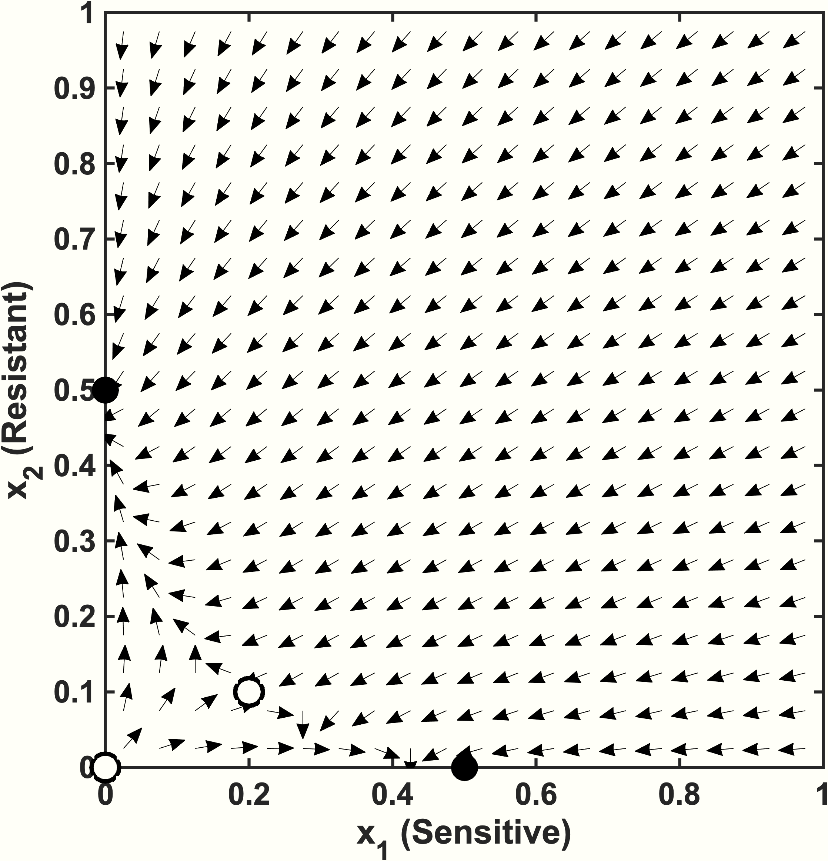
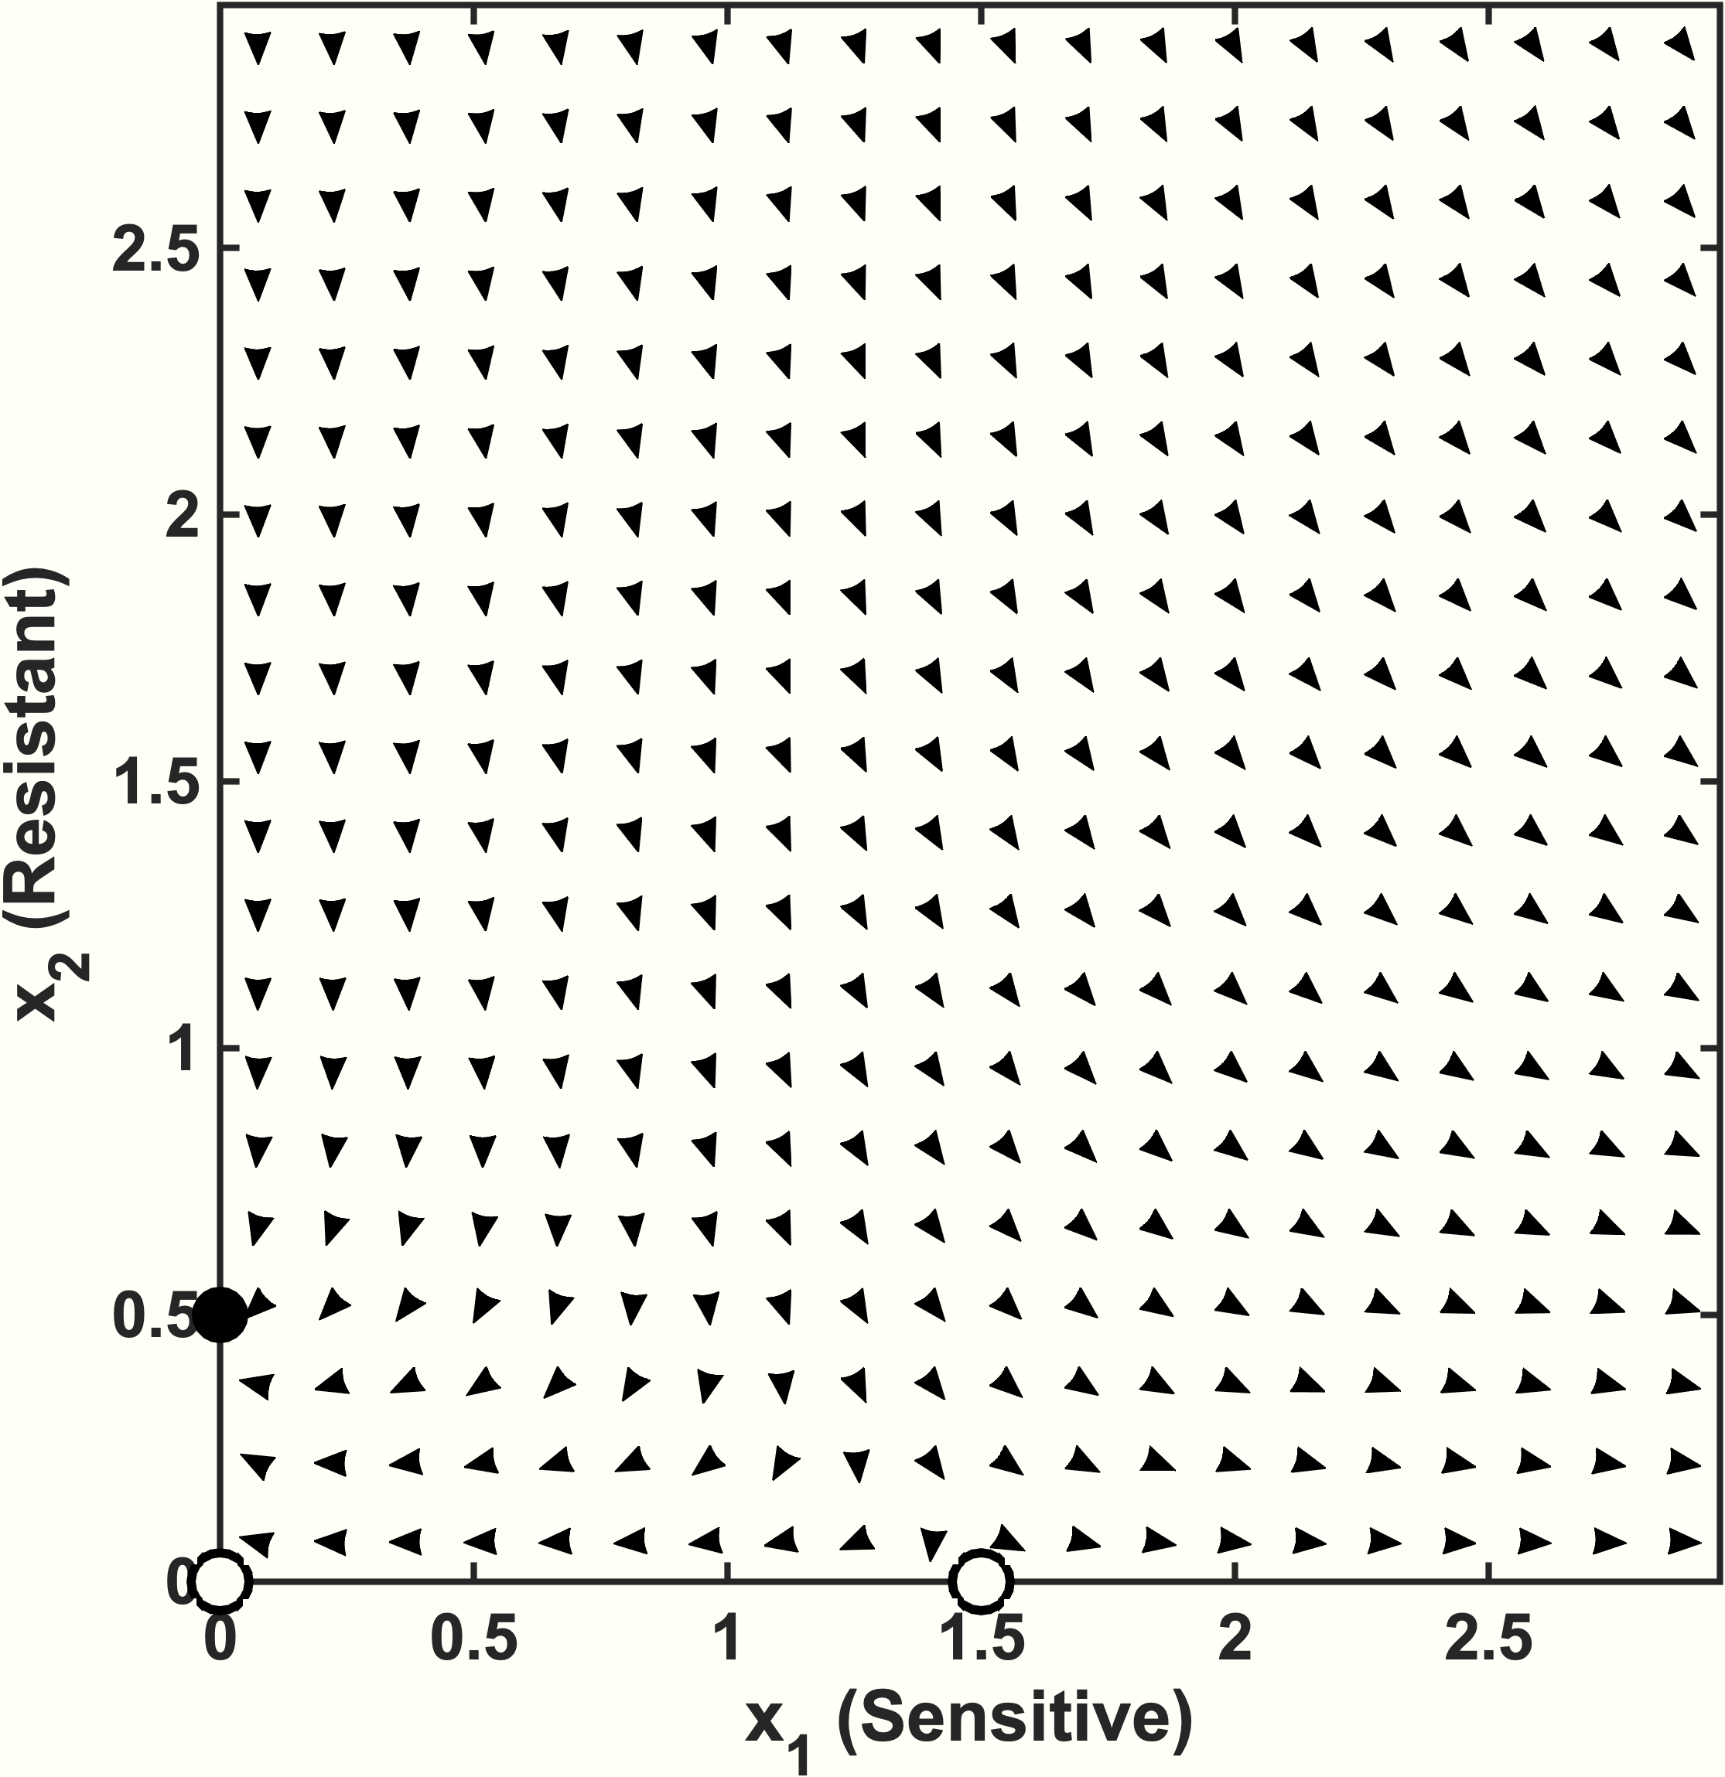
Untreated (c = 0)
Treated (c = 2)
c = 0; r1 = 0.1; r2 = 0.1;
K1 = 1; K2 = 1;
d1 = 0.05; d2 = 0.05;
m12 = 2; m21 = 3;
c = 2; r1 = 0.1; r2 = 0.1;
K1 = 1; K2 = 1;
d1 = 0.05; d2 = 0.05;
m12 = 1.2; m21 = 1.2;
Two stable points:
steady-state is dependent on initial condition
(0, 0) is unstable:
extinction not possible with continuous treatment

